Slide 1
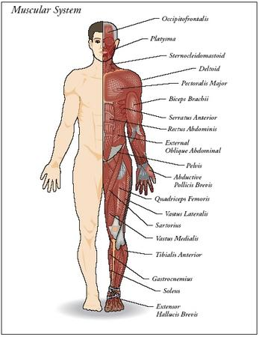
Major Muscle Groups
http://www.faqs.org/health/images/uchr_01_img0105.jpg

Slide 2
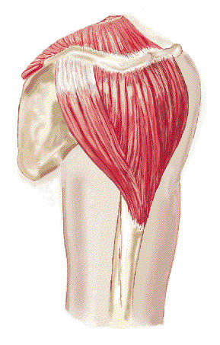
Deltoid
Forms the rounded contour
of the shoulder
3 Parts:
Anterior portion
Middle Portion
Posterior Portion
Movements:
Middle Portion abducts the arm at the shoulder
Posterior portion laterally rotates and extends the arm at the shoulder.
http://www.gpc.edu/~jaliff/deltoid.gif

Slide 3
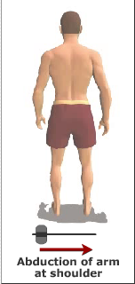
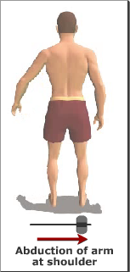
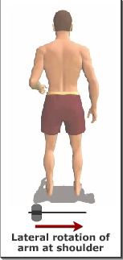
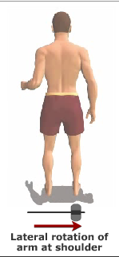
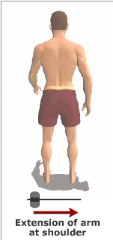
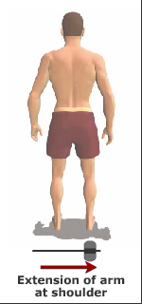
Deltoid Movements
http://www.getbodysmart.com/ap/muscularsystem/armmuscles/posteriormuscles/deltoid/tutorial.html

Slide 4
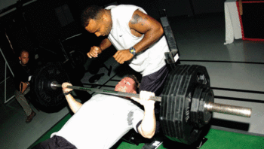
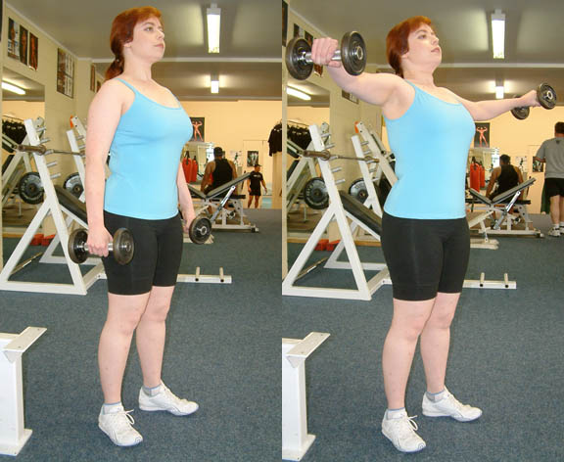
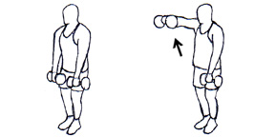
How To Strengthen Deltoid Muscles
http://en.wikipedia.org/wiki/Image:Bench_press.gif | http://en.wikipedia.org/wiki/Image:DumbbellLateralRaise.JPG | http://www.pro-weight-training.com/Big/front_dumbell_raises%20copybig.jpg
Bench Press (to train front portion of deltoid muscle) | Lateral Raises/Shoulder Fly (to train middle portion of deltoid muscle) | Inverse Lateral Raises (to train posterior portion of deltoid muscle)

Slide 5
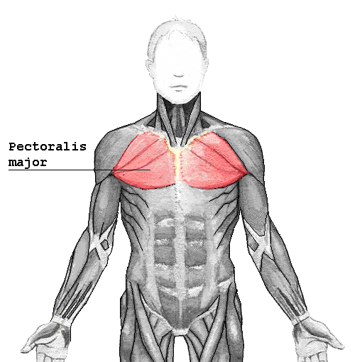
Pectoralis
A thick muscle
that covers
the anterior
(upper front)
part of the chest
http://upload.wikimedia.org/wikipedia/commons/6/6c/Pectoralis_major.png

Slide 6
Pectoralis Movement
Types of movement:
Transverse Flexion
moving the upper arm toward and across the chest with the elbows facing out to the sides
Transverse Abduction
moving the upper arm away from the chest with the elbows facing down
Internal
turning the upper arm inward
Adduction
moving the upper arm down to the side toward the body
Extension
moving the upper arm down to the rear

Slide 7
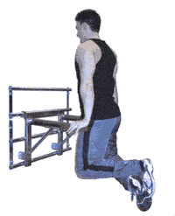
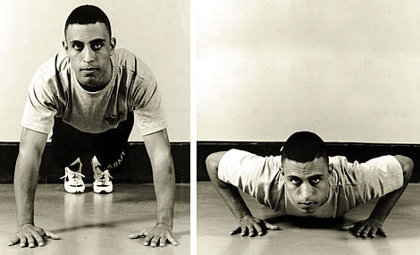
How To Strengthen Pectoralis Muscle
http://en.wikipedia.org/wiki/Image:Bench_press.gif |  | http://www.myfit.ca/exercisedatabase/images/dips.gif
Bench Press | Press Up/Push Up | Dip
http://www.baseops.net/basictraining/pushup1.jpg

Slide 8
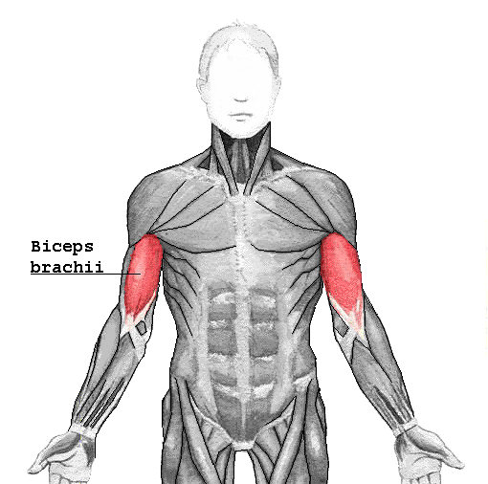
Bicep
muscle located on the
upper arm
Is tri-articulate, meaning
that it works across three joints
Shoulder joint
Elbow joint
Proximinal-radioulnar joint
http://upload.wikimedia.org/wikipedia/commons/6/6c/biceps_brachii.png

Slide 9
Biceps Movement
Joint | Associated Movement
Shoulder | flexion (bringing arm upward by a forward motion)
Elbow | flexion
Proximinal-radioulnar | supination of the forearm (extended the forearm, hand, and fingers)

Slide 10
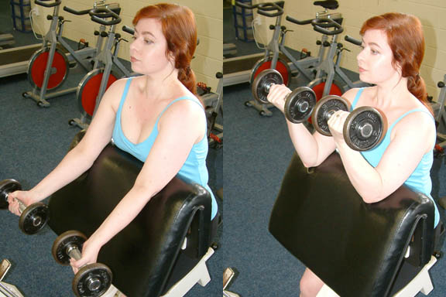
How To Strengthen Biceps Muscle
Can be strengthened through resisted elbow flexion, aka a curling motion
http://upload.wikimedia.org/wikipedia/commons/c/cc/PreacherBenchBicepsCurl.JPG |  | http://www.beginnertriathlete.com/cms/articleimages/874/Bicep-Curl-Cable-Straight2.jpg
Biceps curl |  | Cable Curl

Slide 11
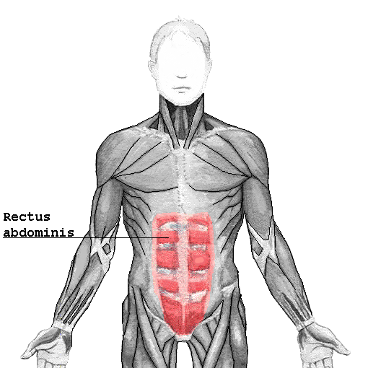
Rectus Abdominis
extends from front of the ribs
to front of the pelvis
Main job is to flex the spine
forward
Well known “6-pack abs” comes from a very strong rectus abdominus
http://www.meddean.luc.edu/lumen/MedEd/GrossAnatomy/dissector/mml/reca.htm

Slide 12
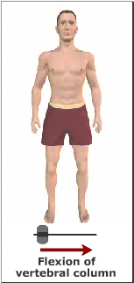
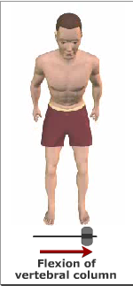
Rectus Abdominis Movement
Major movement of the rectus abdominus is flexion of the spine
http://www.getbodysmart.com/ap/muscularsystem/abdominalmuscles/rectusabdominis/tutorial.html

Slide 13
How To Strengthen the Rectus Abdominis
Crunch

Slide 14
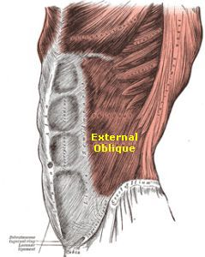
External Obliques
three of them on each side of the
rectus abdominus
allows the trunk to twist, but to
the opposite side that the muscle contracts (unique characteristic of that group of muscles)
assists with exhalation
supports the organs inside the body cavity
http://www.free-ab-workout.com/images/ExternalObliques-correctedTEXT.jpg

Slide 15
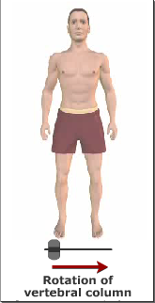
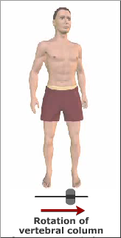
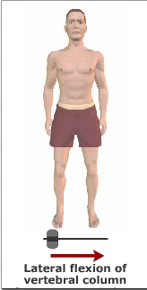
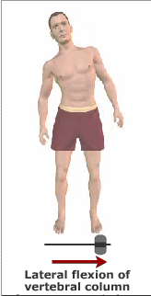
External Oblique Movement
http://www.getbodysmart.com/ap/muscularsystem/backabdomen/abdomen/externaloblique/tutorial.html

Slide 16
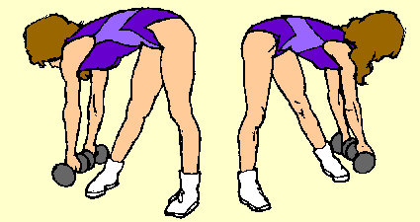
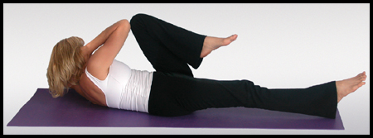
How To Strenghten External Obliques
Side Rotation Crunches
Torso Twist
http://i.timeinc.net/golfonline/images/fitness/yoga/bicycle.jpg
http://www.askthehealthclub.com/images/WT-Exercise/abdominals-alternate%20twisting%20dumbbell%20bends.gif

Slide 17
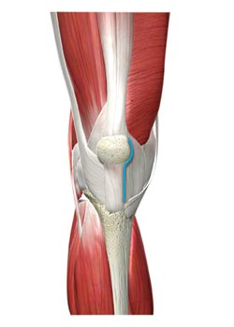
Quadricep
Includes the four major
muscles on the front of the
thigh (quad=4)
Is the extensor muscle (muscle that opens a joint) of the knee
Is crucial for walking, running, squatting, and jumping
http://www.zimmer.com/web/images/products/joints/knees/QuadSparing.jpg

Slide 18
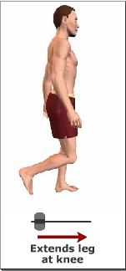
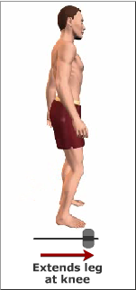
Quadricep Movement
http://www.getbodysmart.com/ap/muscularsystem/legmuscles/vastusmedialis/tutorial.html

Slide 19
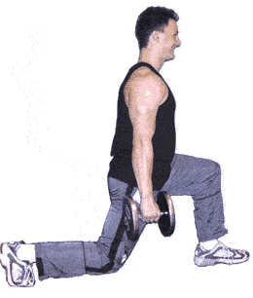
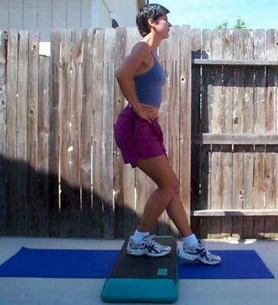
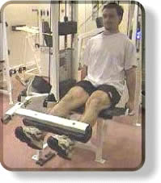
How To Strengthen Quadricep Muscles
http://www.fitstep.com/Library/Exercises/Leg_extensions.htm | http://www.myfit.ca/exercisedatabase/images/lunges.gif | http://z.about.com/d/exercise/1/0/a/9/stepsquat.jpg
Leg Extensions | Lunges | Step Squat

Slide 20
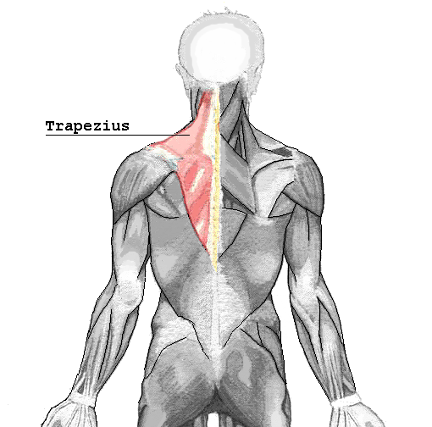
Trapezius
A large superficial
muscle on the back
Controls shrugging the shoulders up and down, and drawing the shoulder blades together
Strain on trapezius is often the cause of lower neck pain
http://upload.wikimedia.org/wikipedia/commons/6/60/Trapezius.png

Slide 21
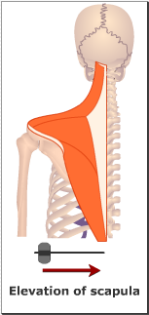
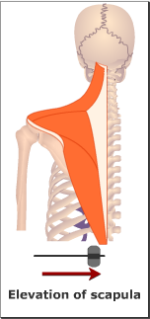
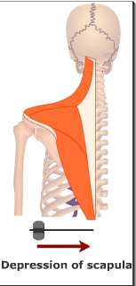
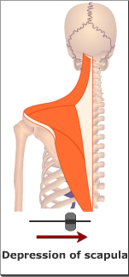
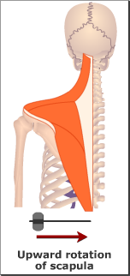
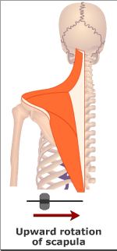
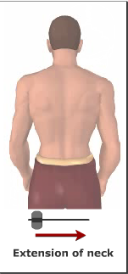
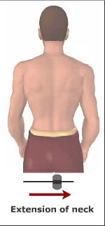
Trapezius Movement
http://www.getbodysmart.com/ap/muscularsystem/shouldermuscles/posteriormuscles/trapezius/tutorial.html

Slide 22
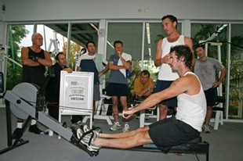
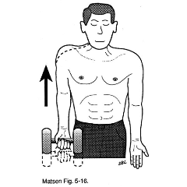
How To Strengthen Trapezius Muscles
http://www.melvillecity.com.au/news-folder/olympic-rower-shows-201coarsome201d-technique-at-melville-aquatic-fitness-centre/technique-session-2-small.jpg/image_mini | http://www.orthop.washington.edu/_Rainbow/Album/10357ma282218f-1128-496f-b519-90e97be2b0be.gif
Standing Rowing | Shoulder Shrugs

Slide 23
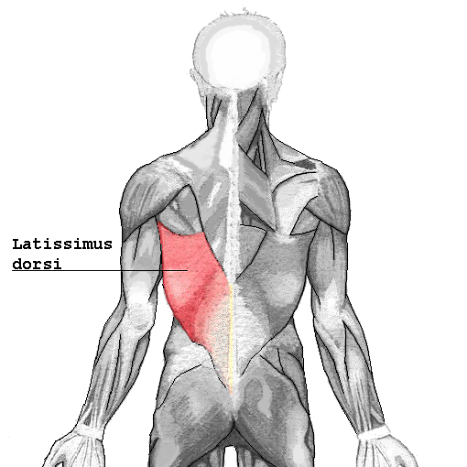
Latissimus Dorsi
Triangular shaped
muscle
Covers the lumbar part
of the back
http://upload.wikimedia.org/wikipedia/commons/7/7d/Latissimus_dorsi.png

Slide 24
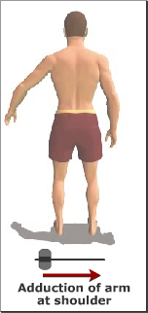
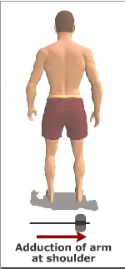
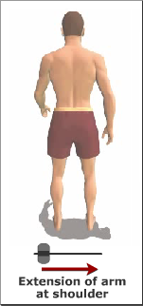
Latissimus Dorsi Movement

Slide 25
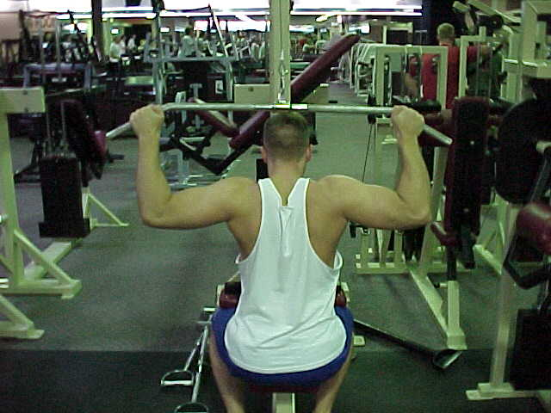
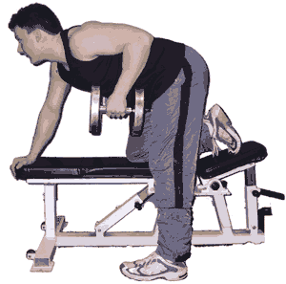
How To Strengthen Latissimus Dorsi
http://www.nku.edu/~issues/weightlifting/MVC-033S.JPG | http://www.myfit.ca/exercisedatabase/images/onearmrow.gif
Lateral Pull Down | One Arm Row

Slide 26
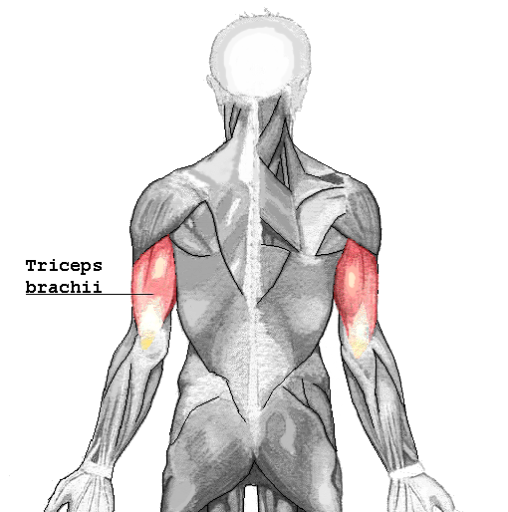
Tricep
Large muscle that runs along
the back of the upper arm
Is an extensor muscle (opens at a joint)
Works in coordination with the biceps which are flexor muscles (bends at a joint)
http://upload.wikimedia.org/wikipedia/commons/8/83/Triceps_brachii.png

Slide 27
Tricep Movement
http://www.getbodysmart.com/ap/muscularsystem/armmuscles/posteriormuscles/tricepslong/tutorial.html

Slide 28
How To Strengthen Triceps Muscle
http://www.ironworkout.com/ohdb.jpg | http://www.patrickholford.com/imagelibrary/tricep%20dip.JPG
Tricep Extension | Tricep Dip

Slide 29
Gluteus Maximus
Makes up shape and
appearance of the buttocks
Maintains the trunk in the
erect posture
http://upload.wikimedia.org/wikipedia/commons/7/70/Posterior_Hip_Muscles_3.PNG

Slide 30
Gluteus Maximus Movement

Slide 31
How To Strengthen Gluteus Maximus
http://www.dkimages.com/discover/previews/913/50406340.JPG | http://www.dkimages.com/discover/previews/913/50406371.JPG
Squats | Lunges

Slide 32
Hamstring
They begin just underneath the gluteus maximus and attach to the tibia
Primary function is knee flexion (bringing the heel towards the buttocks)
When exercised without being stretched, hamstring injuries (strains, pulls, etc.) are very common
http://www.myfit.ca/Muscle%20Anatomy/Hamstrings-or-Biceps-Femori.jpg

Slide 33
Hamstring Movement
http://www.getbodysmart.com/ap/muscularsystem/legmuscles/bicepslong/tutorial.html

Slide 34
How To Strengthen Hamstring Muscle
http://www.bodypowerusa.com/bodysolidpics1/images/GLCE365_Leg%20Extension.jpg | http://www.mthotham.com.au/today/snowtech/images/dead-lift.jpg
Leg Curls | Deadlift (straight-legged)

Slide 35
Calf
Muscles at the bottom of the leg
Function is to stabilize during walking, runing, and jumping
2 parts Gastrocnemius & Soleus
http://www.thorntonross.com/crampex/images/muscle-diagram.jpg

Slide 36
Calf Movement

Slide 37
How To Strengthen Calf Muscles
http://www.dkimages.com/discover/previews/913/50406340.JPG | http://www.nku.edu/~issues/weightlifting/MVC-027S.JPG
Squats | Tip-Toes

